Slide 1

GRAPH THEORY AND ITS APPLICATIONS
Dr. Arti Arya
Department of Computer Science & Engineering

Slide 2

GRAPH THEORY AND ITS APPLICATIONS
TREES
Dr. Arti Arya
Department of Computer Science & Engineering

Slide 3
Graph Theory and its Applications Acknowledgement
The inputs to the slides are by Dr. Surabhi Narayan and by Dr. Arti Arya. The sources of the information other than text book is mentioned wherever used.

Slide 4
Graph Theory and its Applications Trees
Minimum Spanning Tree
Let G(V,E) be a graph and there is a weight/cost associated with each edge of G. Then G is called a weighted graph and the positive real number associated with an edge e is called the weight of the edge e.
Let T be a spanning tree of this graph G. The sum of all weights of all the branches is called the weight of tree T.
A spanning tree whose weight is the least is called a Minimal Spanning Tree(MST) of the graph.

Slide 5
Graph Theory and its Applications Trees
Minimum Spanning Tree
There are several methods of constructing Minimal Spanning Tree.
Kruskal’s Algorithm
Prim’s Algorithm
Boruvka’s Algorithm
Reverse Delete Algorithm

Slide 6
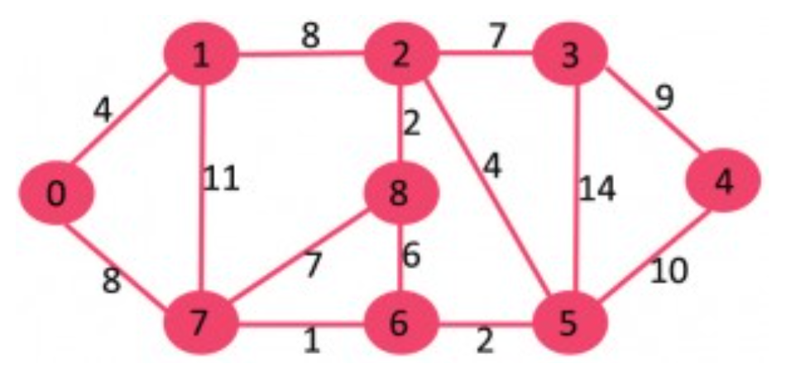
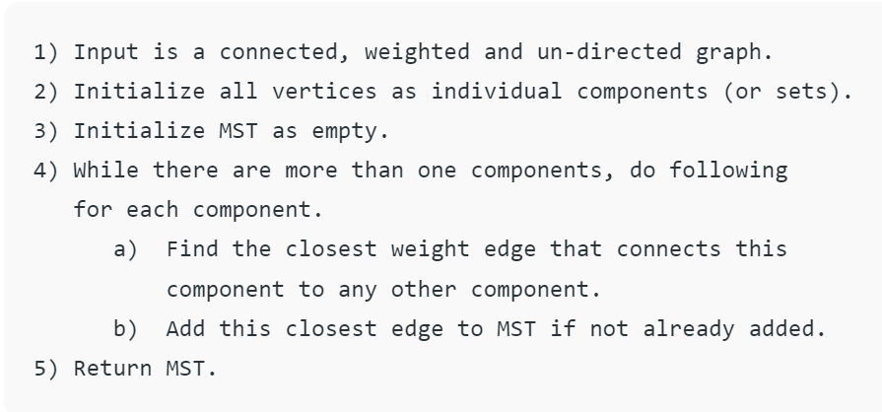
Graph Theory and its Applications Minimum Spanning Tree: Bourvka’s Algorithm
Note that an edge can be selected twice by two different components.
https://www.geeksforgeeks.org/boruvkas-algorithm-greedy-algo-9/

Slide 7
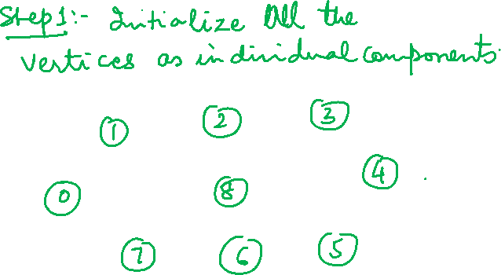
Graph Theory and its Applications Minimum Spanning Tree: Apply Bourvka’s Algorithm

Slide 8
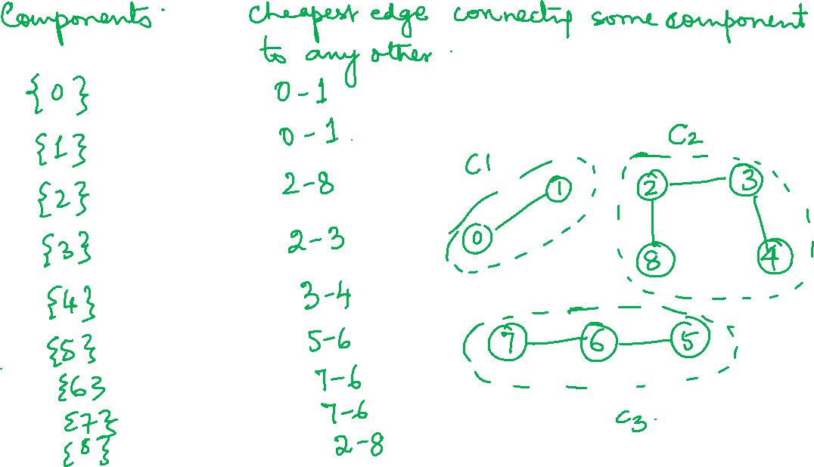

Slide 9
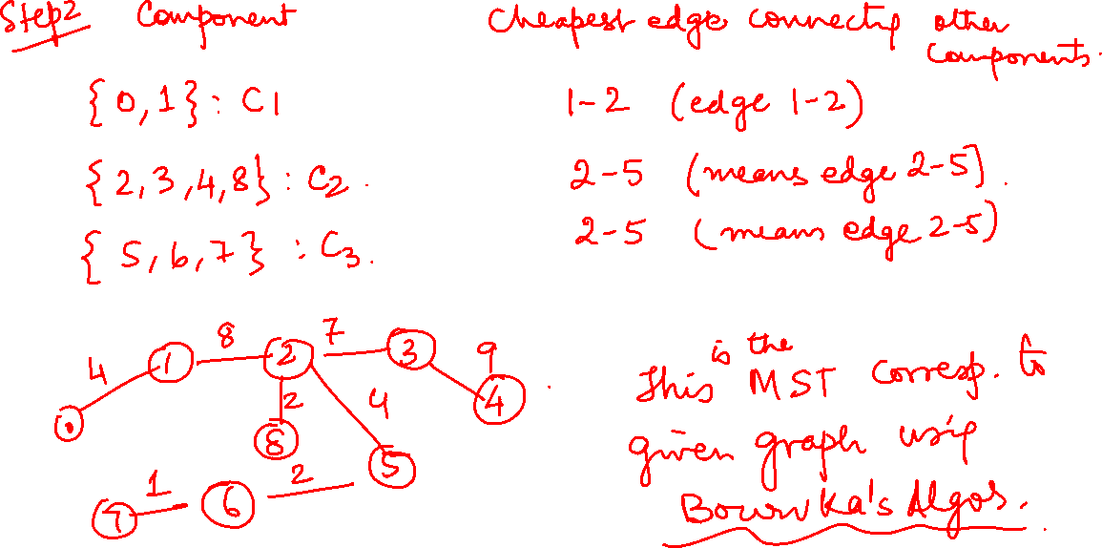

Slide 11
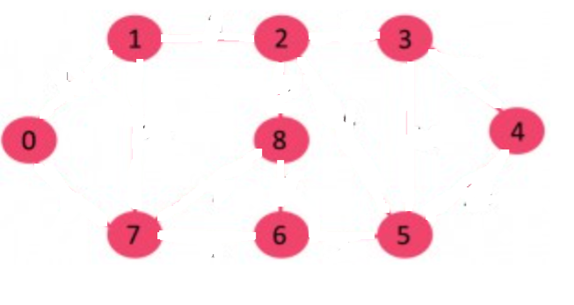
Graph Theory and its Applications Minimum Spanning Tree: Apply Bourvka’s Algorithm
https://www.geeksforgeeks.org/boruvkas-algorithm-greedy-algo-9/

Slide 12
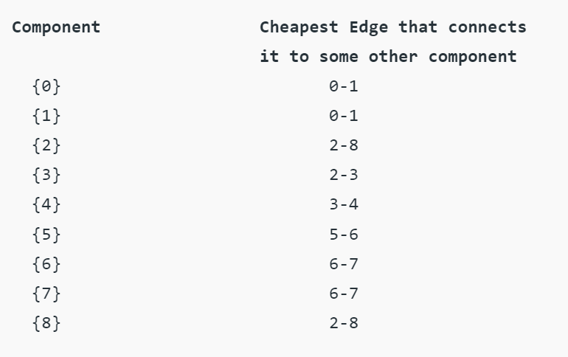
Graph Theory and its Applications Minimum Spanning Tree: Apply Bourvka’s Algorithm
https://www.geeksforgeeks.org/boruvkas-algorithm-greedy-algo-9/

Slide 13
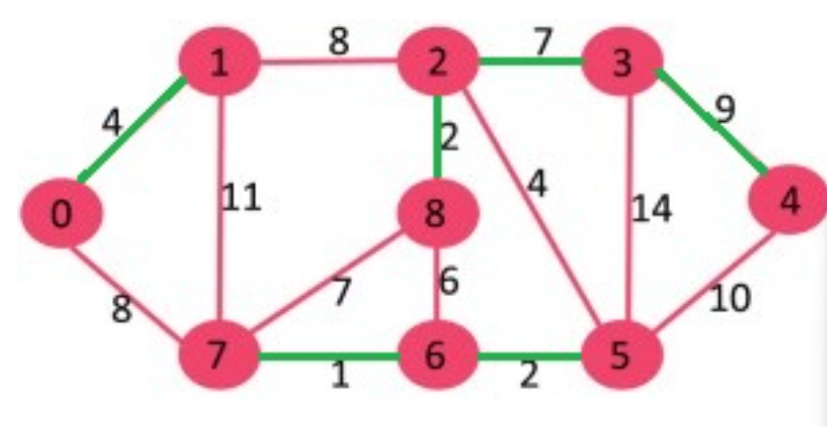
Graph Theory and its Applications Minimum Spanning Tree: Apply Bourvka’s Algorithm
https://www.geeksforgeeks.org/boruvkas-algorithm-greedy-algo-9/

Slide 14
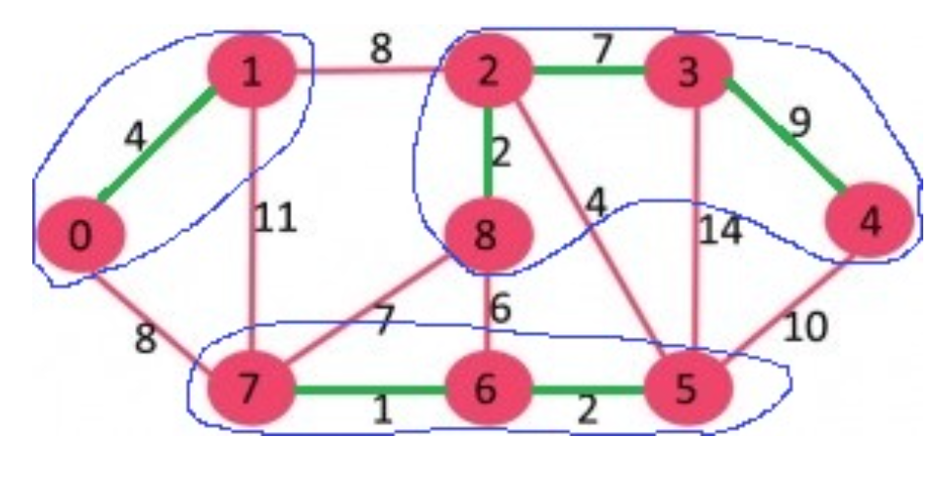
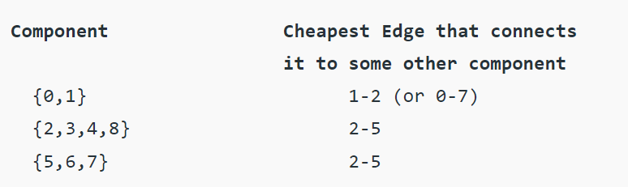
Graph Theory and its Applications Minimum Spanning Tree: Apply Bourvka’s Algorithm
https://www.geeksforgeeks.org/boruvkas-algorithm-greedy-algo-9/

Slide 15
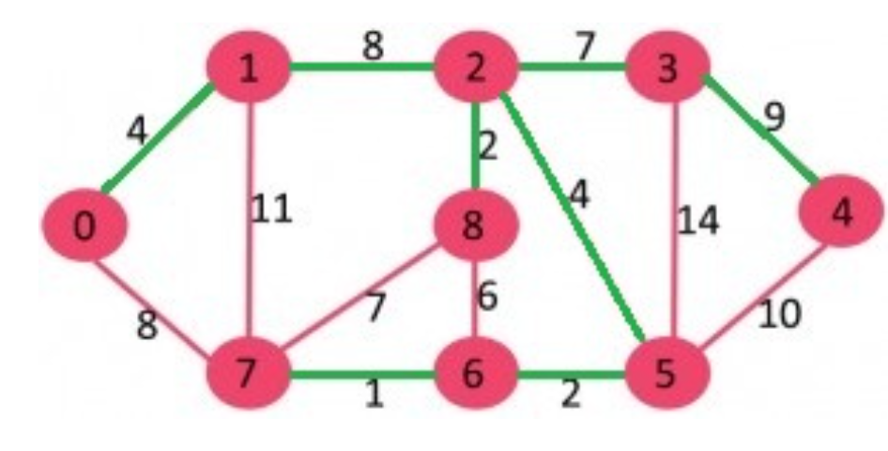
Graph Theory and its Applications Minimum Spanning Tree: Apply Bourvka’s Algorithm
The input graph is represented as a collection of edges and Union-Find Data structure is used to keep track of components.
https://www.geeksforgeeks.org/boruvkas-algorithm-greedy-algo-9/

Slide 16
Graph Theory and its Applications Minimum Spanning Tree
a
8
b
6 8 ₄ d | 6 7
4 | 5 4
9
c
e
9
f
6
g

Slide 18
Graph Theory and its Applications Minimum Spanning Tree
0
5
8
9
1
2
10
11
15
3
4
7

Slide 19
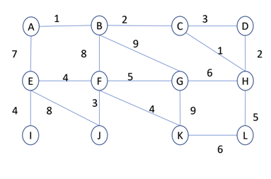
Graph Theory and its Applications Minimum Spanning Tree

Slide 20
Graph Theory and its Applications Minimum Spanning Tree
B
14
C
8
22
26
6
11
A
4
D
3
E
2
28
16
5
25
20
F
G
H
10
27
6

Slide 21
Graph Theory and its Applications Minimum Spanning Tree
8
7
1
2
3
9
4
11
4
14
0
8
4
7
8
7
6
5
10
1
2

Slide 22
Graph Theory and its Applications Reverse Delete Algorithm
Reverse delete algorithm is closely related to Kruskal’s algorithm.
In Kruskal’s algorithm edges are sorted in increasing order and an edge is included in the spanning tree if it does not result in a cycle and until there are v-1 edges in spanning tree.
In Reverse delete algorithm we sort edges in decreasing order of their weights. The current edge is picked if excluding the current edge does not cause disconnection of the graph.

Slide 23
Graph Theory and its Applications Reverse Delete Algorithm
Sort all edges of graph in non increasing order of edge weights.
Initialize MST as original graph and remove extra edges using step 3.
Pick the highest weight edge from remaining edges and check if deleting the edge disconnects the graph or not. If the graph disconnects then we don’t delete the edge, else we delete the edge and continue.

Slide 24
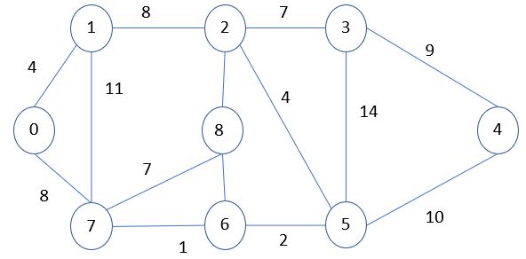
Graph Theory and its Applications Minimum Spanning Tree

Slide 25
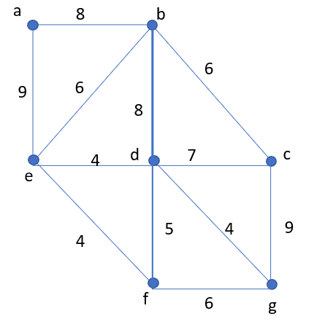
Graph Theory and its Applications Reverse Delete Algorithm

Slide 26
Graph Theory and its Applications Reverse Delete Algorithm

Slide 27
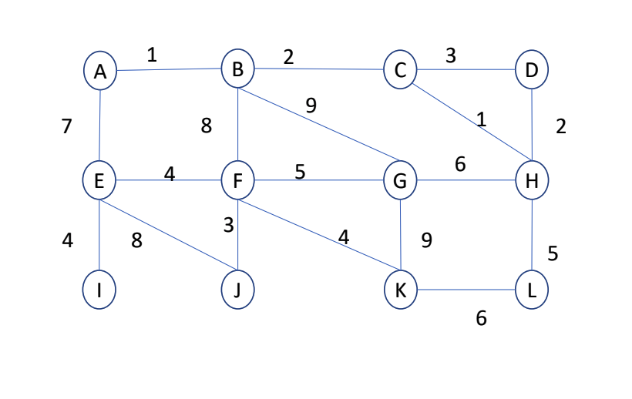
Graph Theory and its Applications Minimum Spanning Tree

Slide 28
Graph Theory and its Applications Minimum Spanning Tree
B
14
C
8
22
26
6
11
A
4
D
3
E
2
28
16
5
25
20
F
G
H
10
27
6

Slide 29
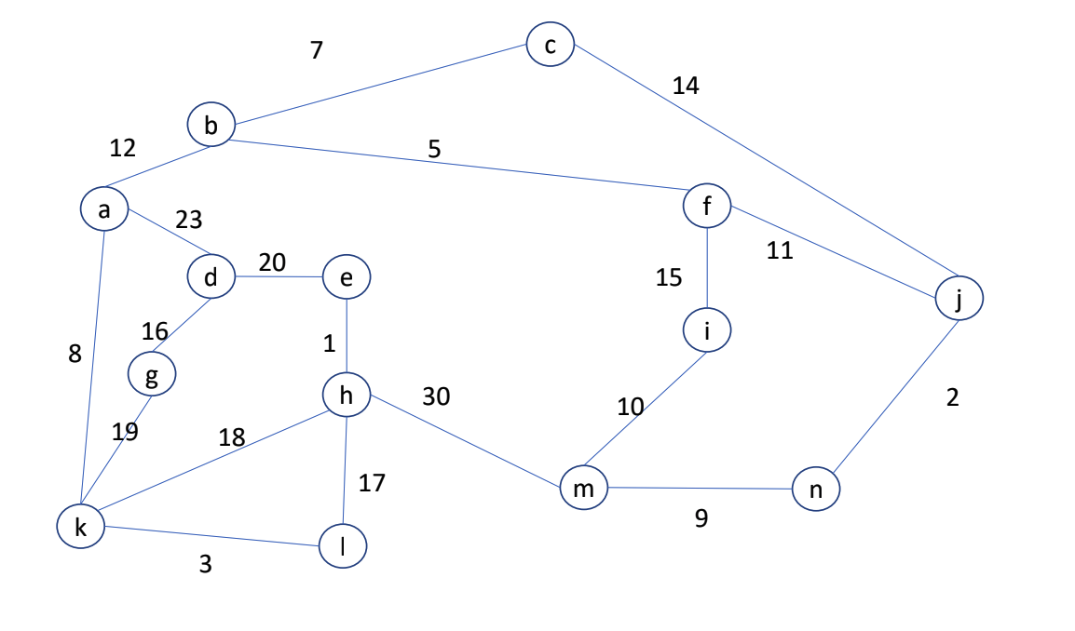
Graph Theory and its Applications Minimum Spanning Tree

Slide 30
THANK YOU
Dr. Arti Arya
Department of Computer Science &Engineering
artiarya@pes.edu

